Slide 1

Impact of free app promotion on future sales: A case study on Amazon Appstore
Harshal A. Chaudhari, John W. Byers
Boston University Computer Science
Platform Strategy Research Symposium 2017
Notes:
1. Smartphone are changing the way that people communicate, work and socialize.

Slide 2
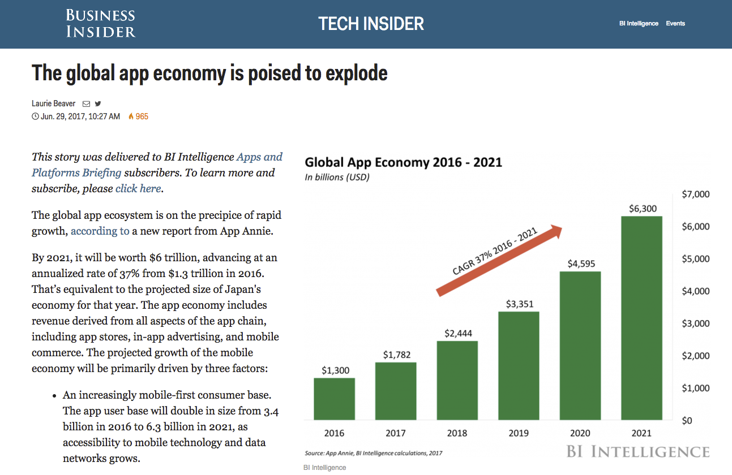
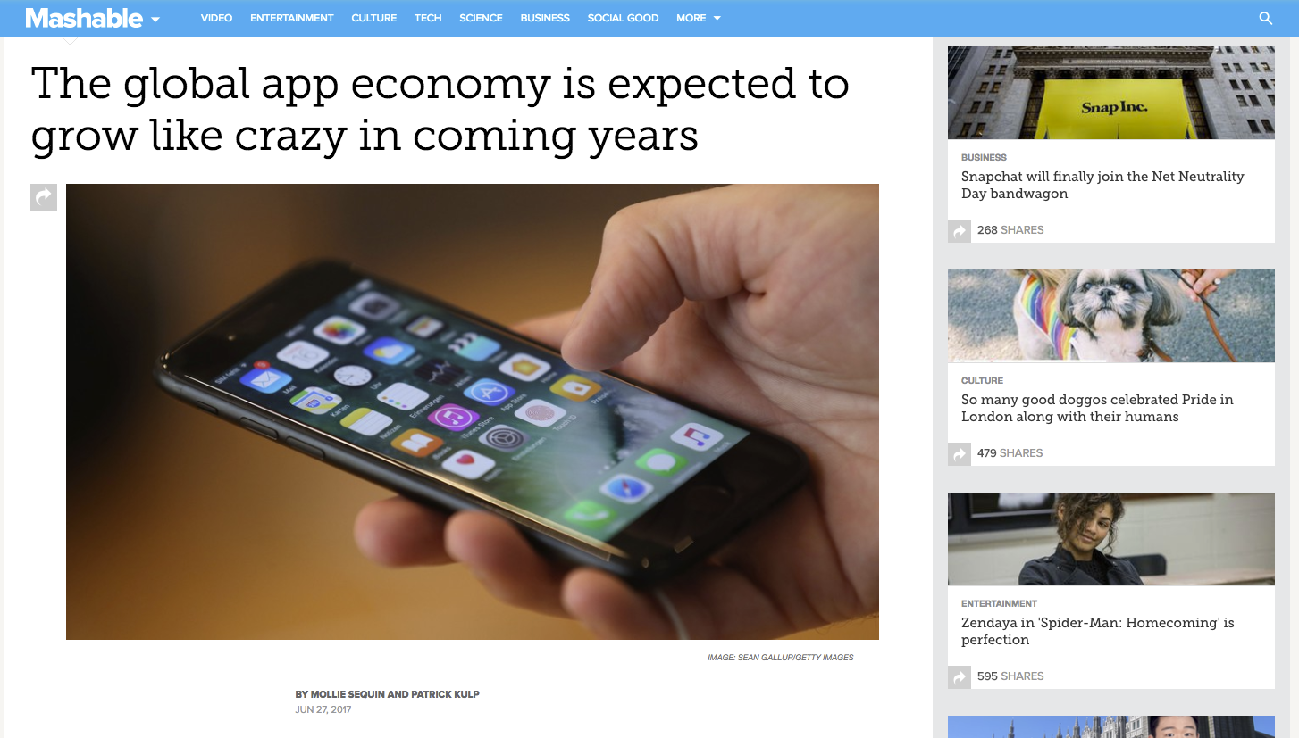
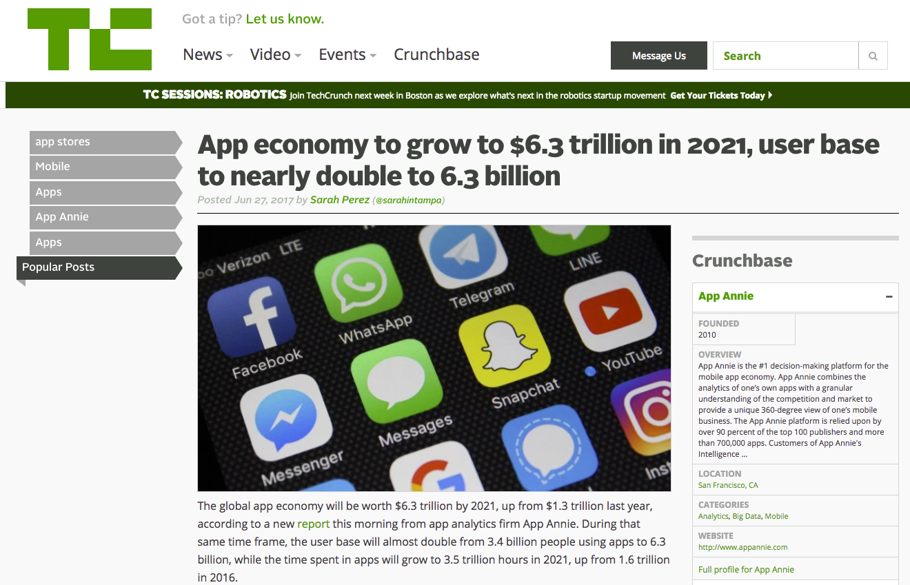
The App Economy

Slide 3
The App Economy
Global app economy will grow from $1.3 trillion in 2016, to $6.3 trillion in 2021.
User base will double from 3.4 billion in 2016, to 6.3 billion in 2021.
Google Playstore combined with third-party Android marketplaces will overtake iOS App Store, thanks to China.

Slide 4
Universe of Appstores
Source: AppArray World
Notes:
Change title.

Slide 5
Universe of Appstores
Source: AppArray World
Notes:
Change title.

Slide 6
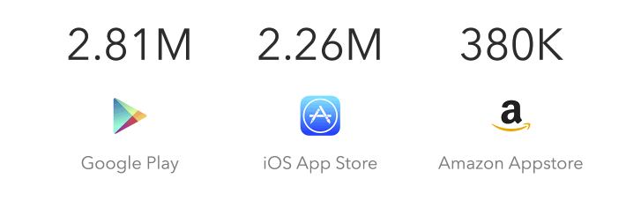
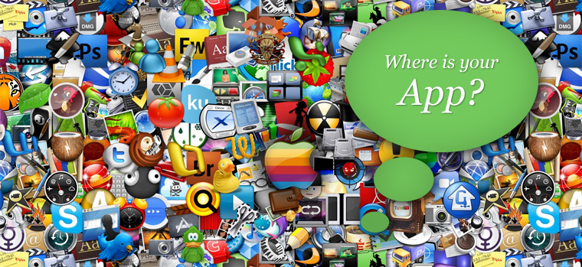
Sea of Apps
2.8M 2.2M 600K
Google Playstore iOS App Store Amazon Appstore
Source: AppFigures
Notes:
2. Apple Kickstarted the economy in 2008 after the launch of iPhone. 65,000 apps added to the store in less than 1 year.
3. When the App Store opened in 2008, many internet companies took a wait-and-see approach. Google, Facebook, Amazon, and Pandora all released basic apps, but that left a lot of room for independent development. iPhone owners were hungry in those days for the new experiences enabled by their phones, downloading more than 10 apps a month,
4. But quirky independent apps dominated the inaugural list of the year’s most downloaded software: the top seller was a virtual koi pond; the list also included an app that simulated drinking a beer. There was also a booming market for basic utilities: top sellers included a level tool, a spell checker, and a voice recorder.
5. Many of the independent developer apps became native features of the operating systems. For eg. Crop feature, Torch using the flash.
5. But the range of opportunities in consumer software has narrowed dramatically — to a couple of swim lanes

Slide 7
How do Consumers discover Apps?
Challenge of App Discovery
iOS Appstore has over 1.5 million abandoned apps, Google Playstore even more.
In United States, over 50% of smartphone users install zero new apps every month!
App Store Optimization!
Optimize mobile apps to rank higher in an app store’s search results.
Aggressive advertising campaigns.
Freemium apps.
In-app purchases.
Notes:
Average person spends 80 percent of their time on mobile devices using only three apps.
"After a while, the saturation of apps catches up to the user growth," says Ryan Sarver, a venture capitalist at Redpoint Ventures. "And people are no longer searching — they’ve got the apps that they need."
In 2011, 63 percent of apps were paid downloads, selling for an average of $3.64 apiece. By last year, a mere 27 percent of downloads were paid, and the average price had fallen to $1.27. Today, profiting from the App Store most often requires a mix of in-app purchases, subscriptions, and advertising.
Arnold Schwarzenegger’s $5 million SuperBowl add for the game “Mobile Strike” !!

Slide 8
‘Amazon Free App of the Day’ promotion

Slide 9
What’s in it for me?
App developer
High visibility spot on appstore.
Additional free marketing from Amazon.
Post-promotion exposure due to improved sales rank and word-of-mouth.
But, obvious risk of cannibalization of future sales.
Amazon Appstore
Decidedly second-tier app store – improve market share.
Also builds word-of-mouth, hopefully leverages network effects.
But, is this really worth the effort and opportunity cost?
Notes:
Network effect: Free apps -> More customers -> Attracts more developers -> More apps -> More customers -> … Amazon benefits tremendously from the network effect of promotion. Amazon loses relatively very small revenue. Developers benefit from the exposure, but get zero revenue during promotion. They trust that increased exposure post promotion can offset lost revenue.
Anecdotal evidence :
Developers of strategy game, Starlink, reported an 8,000% increase in downloads.
Developers of podcast app, Pocket Caster, reported no increase in downloads post-promotion, but significantly lower star ratings.

Slide 10
Related Prior Work
Sales Rank as a proxy for app downloads: Brynjolfsson et al. (2003) have shown the power law relationship between book sales and their sales rank on Amazon.
Evaluating promotion strategies: Liu et al. (2012) empirically showed that freemium strategies positively impact app sales on Google Playstore.
Impact on star rating: Luca (2011) showed that 1-star increase in a restaurant’s Yelp rating leads to 5-9% increase in revenue.
Unintended harm from discounted promotion: Byers et al. (2012) showed a Groupon effect: 10% decline in Yelp rating post-promotion.
Notes:
We prefer to use sales rank as dependent variable over ‘number of consumer reviews’ used by other researchers because. - Sales rank is direct indicator of sales. - Large percentage of consumer reviews are not accompanied by textual review. They just contain star rating. Such reviews are not publicly displayed by the appstores.
Freemium strategy is a unique to appstores. Basic features of app are available for free, while more advanced features need to be purchased.
External sources of information affect purchase decisions: Moe (2003) showed that directed searches of exact product names affect online consumer purchases.

Slide 11
Part 1: Impact within Amazon Appstore
Does higher app visibility during promotion lead to increased sales?
Are there any down sides to promotion?
Do all promoted apps benefit equally from the promotion?

Slide 12
Part 1: Impact within Amazon Appstore
Does higher app visibility during promotion lead to increased sales? Promotion results into an immediate improvement in sales, which lasts for 3-4 months after promotion.
Are there any down sides to promotion?
Do all promoted apps benefit equally from the promotion?

Slide 13
Part 1: Impact within Amazon Appstore
Does higher app visibility during promotion lead to increased sales? Promotion results into an immediate improvement in sales, which lasts for 3-4 months after promotion.
Are there any down sides to promotion? All promoted apps experience a decline in user ratings after promotion.
Do all promoted apps benefit equally from the promotion?

Slide 14
Part 1: Impact within Amazon Appstore
Does higher app visibility during promotion lead to increased sales? Promotion results into an immediate improvement in sales, which lasts for 3-4 months after promotion.
Are there any down sides to promotion? All promoted apps experience a decline in user ratings after promotion.
Do all promoted apps benefit equally from the promotion? Low quality apps are the biggest beneficiaries of promotion.

Slide 15
Part2: Impact outside Amazon Appstore
Is there a cross-market spillover effect of promotion?
Is there a decline in user ratings even outside Amazon Appstore?

Slide 16
Part2: Impact outside Amazon Appstore
Is there a cross-market spillover effect of promotion? There is a cross-market spillover effect of Amazon Promotion on Google Playstore, in form of improvement in sales.
Is there a decline in user ratings even outside Amazon Appstore?

Slide 17
Part2: Impact outside Amazon Appstore
Is there a cross-market spillover effect of promotion? There is a cross-market spillover effect of Amazon Promotion on Google Playstore, in form of improvement in sales.
Is there a decline in user ratings even outside Amazon Appstore? There is a decline in user ratings on Google Playstore, however, the decline begins before the actual promotion.

Slide 18
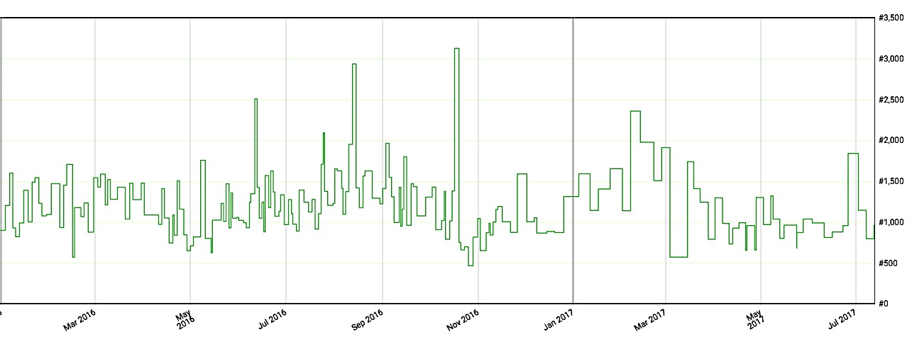
Datasets (web scraping + API calls)
794 apps promoted as Amazon Free App of Day [source: Amazon Appstore] - 179 apps promoted exactly once in 2015
24K distinct Amazon Appstore apps, 800K customer reviews - Sales rank history time-series for 2015 [source: Keepa.com]
566 promoted apps exact-matched with counterparts on Google Playstore - 500K customer reviews - Rank history time-series (within category)
Notes:
Keepa.com : Third party price tracker service for products sold on Amazon
@AmazonAppstore is official Twitter channel of Amazon Appstore. Every morning Free App of Day was tweeted.
Combined automated and manual matching. Zero false positives.
*Important* : Google does not provide overall sales rank due to sheer number of apps, unlike Amazon. They only provide sales rank within app category (eg. Games)

Slide 19
Identification Strategy
Exploit the temporal variation between the “Treated” (promoted) apps and the “Control” apps on Amazon Appstore.

Slide 20
Identification Strategy
Exploit the temporal variation between the “Treated” (promoted) apps and the “Control” apps on Amazon Appstore.
FAD Promotion
“Control” apps
“Treated” apps
Sales Rank
Time

Slide 21
Identification Strategy
Exploit the temporal variation between the “Treated” (promoted) apps and the “Control” apps on Amazon Appstore.
FAD Promotion
“Control” apps
“Treated” apps
Sales Rank
1 | 2 | 3 | 4 | 5 | 6 | 7 | 8 | 9 | 10
0 | 0 | 0 | 0 | 0 | 1 | 2 | 3 | 4 | 5
Age (months)
After = 0
After = 1
Post (months)

Slide 22
Identification Strategy
Exploit the temporal variation between the “Treated” (promoted) apps and the “Control” apps on Amazon Appstore.
“After” measures immediate impact of promotion, while “Post” can be used to measure long-term impact of promotion.
FAD Promotion
“Control” apps
“Treated” apps
Sales Rank
1 | 2 | 3 | 4 | 5 | 6 | 7 | 8 | 9 | 10
0 | 0 | 0 | 0 | 0 | 1 | 2 | 3 | 4 | 5
Age (months)
After = 0
After = 1
Post (months)

Slide 23
Econometric Model
We use ‘within-between’ formulation of multilevel models (Bell and Jones, 2015) to estimate impacts of both time-variant and time-invariant variables on log sales rank, log number of reviews, and star-rating.
Explicit separation of ‘within’ and ‘between’ effects of promotion.
Impact of time-invariant app characteristics can be measured with coefficients.
Auto-correlated and heteroscedastic within-app residuals.
log sales rank for app i in month j

Slide 24
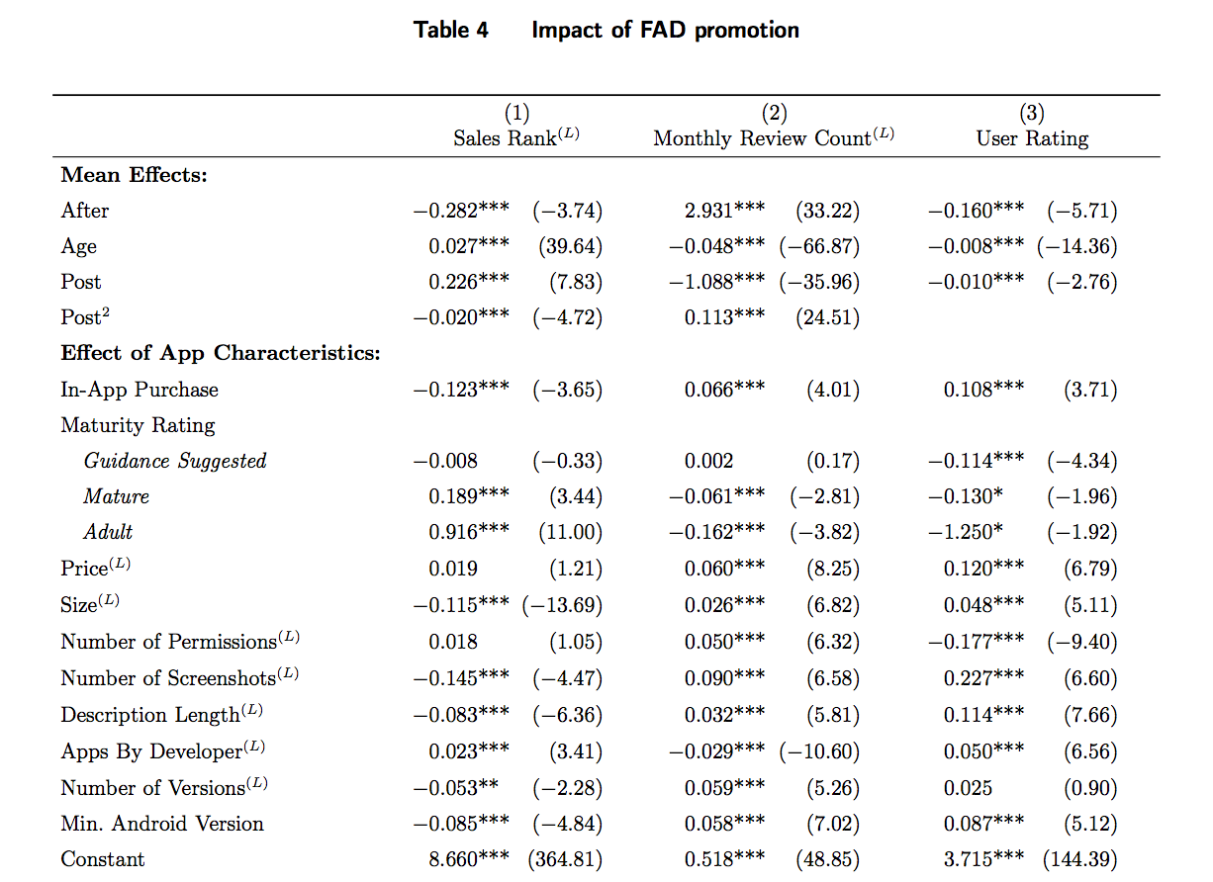

Slide 25
Impact on Sales Rank
25% improvement in the rank immediately after promotion.

Slide 26
Impact on Sales Rank
25% improvement in the rank immediately after promotion.
Improvement in sales rank lasts for 3-4 months.

Slide 27
Impact on User Reviews
Abrupt 18-fold increase in the number of monthly reviews after promotion.

Slide 28
Impact on User Reviews
Abrupt 18-fold increase in the number of monthly reviews after promotion.
Increase in monthly reviews lasts for 4-5 months.

Slide 29
Impact on User Ratings
Abrupt decrease in user rating by 0.16 stars after promotion.

Slide 30
Impact on User Ratings
Abrupt decrease in user rating by 0.16 stars after promotion.
Displayed user ratings never recover.

Slide 31
Impact of app-characteristics on effectiveness of promotion
10% increase in app size decreases post-promotion improvement in sales rank by 1.42%.
An extra screenshot on app profile page improves post-promotion sales rank by 4.5%.
10% increase in app description improves effectiveness of promotion by 2%.
App’s original price or in-app purchase option does not affect effectiveness of promotion.

Slide 32
Part 1: Impact within Amazon Appstore
Does higher app visibility during promotion lead to increased sales? Promotion results into an immediate improvement in sales, which lasts for 3-4 months after promotion.
Are there any down sides to promotion? All promoted apps experience a decline in user ratings after promotion.
Do all promoted apps benefit equally from the promotion? Low quality apps are the biggest beneficiaries of promotion.

Slide 33
Heterogeneous impact of promotion
Do pre-existing biases regarding quality of promoted app affect consumers’ purchase decision during promotion?
We employ a conservative definition of ‘app quality’ by segregating promoted apps based on average sales rank - Rank Categories.
Add control apps to each of the rank categories and re-evaluate previous model.

Slide 34
Impact of promotion on Sales Rank
Sales rank history time-series for 2015 [source: Keepa.com]
‘Bottom Third’ apps experience biggest benefit of promotion.
‘Middle Third’ apps experience immediate benefit, but do worse in long-term.
‘Top Third’ apps experience reasonable benefit in both short-term and long-term.
Notes:
1. Rank categories were formed this way. Avg. sales rank pre-promotion for Promoted apps (treatment) calculated and divided into 3 categories. Control apps put into these categories using their avg. sales rank over entire duration of study. 2. Somewhat surprising result, bottom third (bad apps) benefit the most. This is also evident from the reviews plot, they get the biggest bump in reviews.

Slide 35
Impact of promotion on User Reviews
Sales rank history time-series for 2015 [source: Keepa.com]
‘Bottom Third’ apps experience largest increment in user reviews.
‘Top Third’ apps experience smallest increment in user reviews.
Notes:
1. Rank categories were formed this way. Avg. sales rank pre-promotion for Promoted apps (treatment) calculated and divided into 3 categories. Control apps put into these categories using their avg. sales rank over entire duration of study. 2. Somewhat surprising result, bottom third (bad apps) benefit the most. This is also evident from the reviews plot, they get the biggest bump in reviews.

Slide 36
Impact of promotion on User Ratings
Sales rank history time-series for 2015 [source: Keepa.com]
‘Bottom Third’ apps experience largest decline in post-promotion user ratings.
‘Top Third’ apps seem to experience some decline in user ratings, but confidence intervals are wide.
Notes:
1. Rank categories were formed this way. Avg. sales rank pre-promotion for Promoted apps (treatment) calculated and divided into 3 categories. Control apps put into these categories using their avg. sales rank over entire duration of study. 2. Somewhat surprising result, bottom third (bad apps) benefit the most. This is also evident from the reviews plot, they get the biggest bump in reviews.

Slide 37
Part2: Impact outside Amazon Appstore
Is there a cross-market spillover effect of promotion? There is a cross-market spillover effect of Amazon Promotion on Google Playstore, in form of improvement in sales.
Is there a decline in user ratings even outside Amazon Appstore? There is a decline in user ratings on Google Playstore, however, the decline begins before the actual promotion.

Slide 38
Cross-market spillover on Google Playstore
We do not have data for control group of apps on the Google Playstore.
We identify correlational effects of Amazon promotion on sales rank and user ratings on Google Playstore.
We use simple fixed-effect model as follows,
Standard errors are computed using generalized Huber-White formula, clustered at app-level.

Slide 39
Cross-market spillover effect on Sales Rank
Amazon Free App of the Day promotion improves sales of apps in their competing market, Google Playstore!
Notes:
1. We use 7-day intervals instead of 30-day intervals because the effect is extremely short-lived, difficult to notice on 30-day intervals. 2. There are no control apps on Google side, hence the increasing trend in the plot. Also, why we can only ‘identify’ the effect as correlation. Cannot show causation (although the fact that every promoted app improves its sales on Google Playstore precisely in the week of its promotion on Amazon in a damning evidence of cross-market spillover effect )

Slide 40
Cross-market spillover effect on User Ratings

Slide 41
Cross-market spillover effect on User Ratings
The decline in star ratings appears to begin even before the promotion on Amazon Appstore!
Notes:
1. We use 7-day intervals instead of 30-day intervals because the effect is extremely short-lived, difficult to notice on 30-day intervals. 2. There are no control apps on Google side, hence the increasing trend in the plot. Also, why we can only ‘identify’ the effect as correlation. Cannot show causation (although the fact that every promoted app improves its sales on Google Playstore precisely in the week of its promotion on Amazon in a damning evidence of cross-market spillover effect )

Slide 42
Robustness Checks
Fixed Effects vs. Multilevel Effects model
Fixed effects model is a very specialized case of the more general multilevel models.
Estimation of Fixed effects model provides nearly identical results! Please refer to Table 6 in our paper for side-by-side comparison of the two models.
Controlling for Amazon’s selection bias
Amazon could systematically choose only those apps for promotion which would experience the most benefits.
We use sample matching using propensity scores, suggested by Rosenbaum et al. (1983), to control for Amazon’s selection bias.

Slide 43
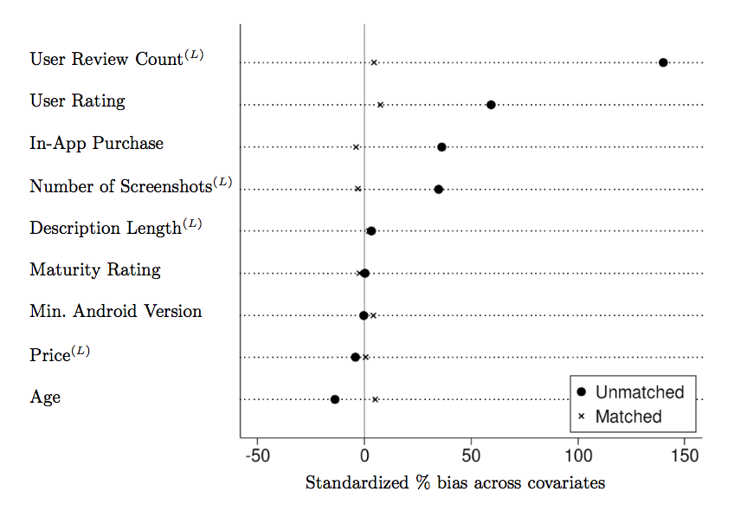
Matching promoted apps with control apps
Our results in estimating the impact of promotion as well as its heterogeneous nature, qualitatively remain the same after using matched sample of control apps.

Slide 44
Conclusions
Effectiveness of promotion depends on the a priori ranking of an app.
The increase in post-promotion sales does not clearly offset the lost revenue on the day of promotion. However, long-term effects of reputation damage notwithstanding, developers of high-quality or low-quality apps benefit from promotion.
For appstores, there exists complex trade-off between promoting quality apps at low price, while mitigating potential losses to app developers’ reputation and profits.
Promotions increase brand-awareness drives sales across appstores for promoted apps.
Quantifying the cannibalization effect of free promotion remains open.

Slide 45
Thank You! Any Questions?

Slide 47
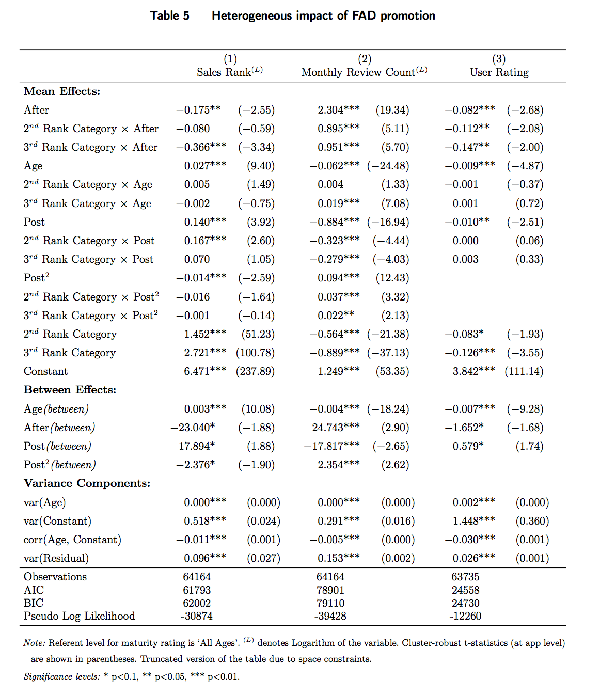

Slide 48
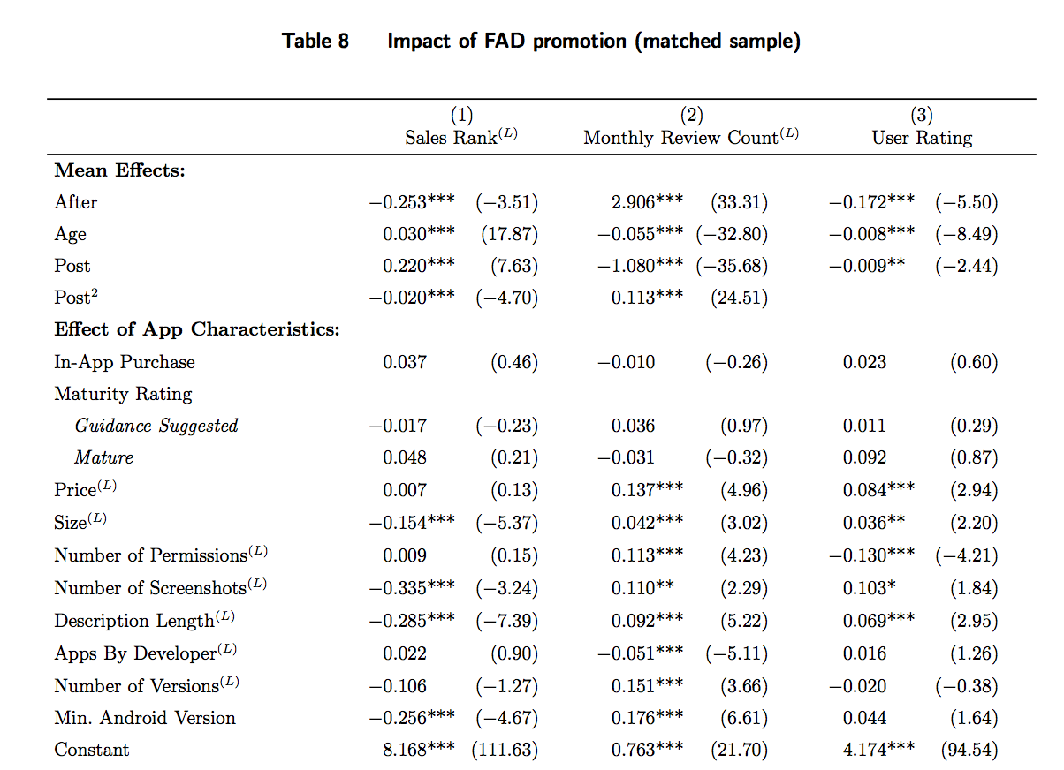

Slide 49
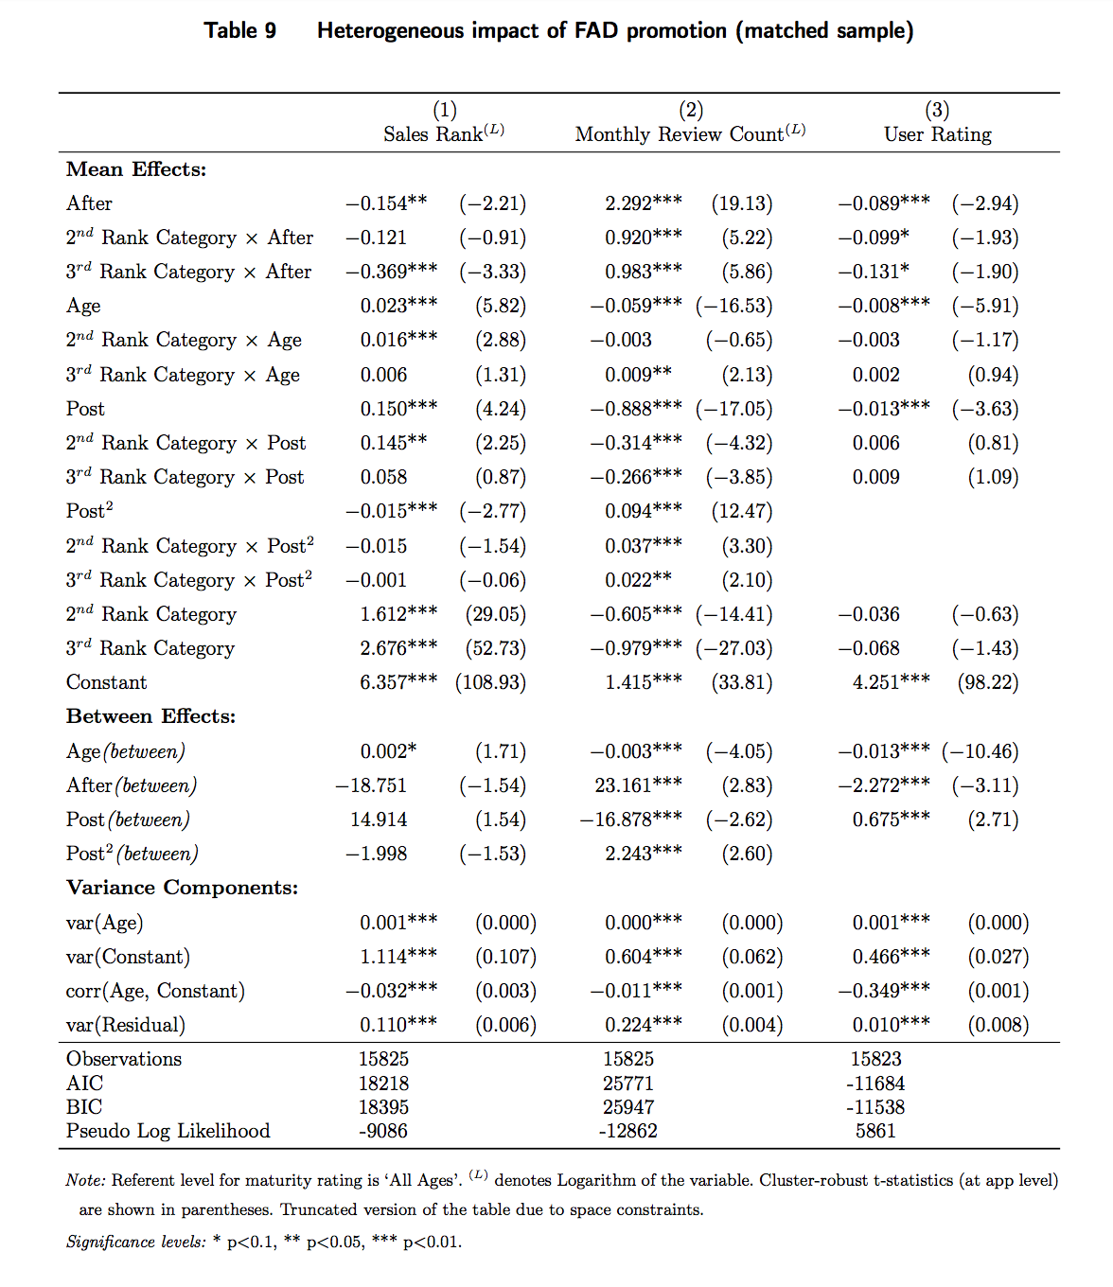

Slide 50
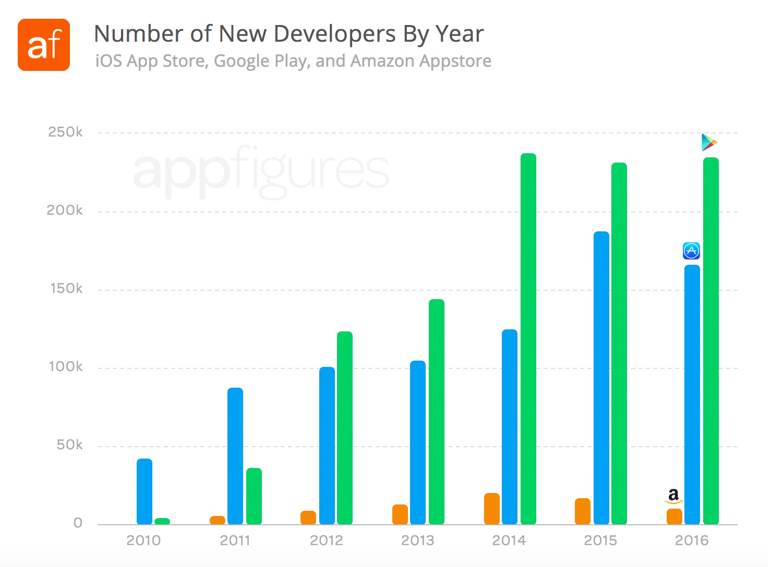

New App Developers By Year
Source: AppFigures

Slide 51
Popularity of appstores among app developers
Low visibility on Google Playstore, but potentially huge market.
Higher visibility on Amazon Appstore, but small potential market.
Notes:
Google – 2.8 mil
Apple – 2.2 mil
Windows – 700k
Amazon - 600k
BBB – 200k Amazon is 3rd party Android appstore. Every android smartphone can install apps from either Google Playstore or the Amazon Appstore. - Extremely high competition to be visible on Google Playstore (primary appstore of android) - Low competition for high visibility on Amazon Appstore, but not many android users use this market.
- App developers have to make a decision on where to publish their apps.

Slide 52
Growth of Amazon Appstore

Slide 53
Econometric Model
We use ‘within-between’ formulation of multilevel models (Bell and Jones, 2015) to estimate impacts of both time-variant and time-invariant variables on sales rank, number of reviews, and star-rating.
Level-1 submodel: where,
Level-2 submodels: where,
Notes:
Dependent variable in the equation below can be sales rank, number of reviews or star rating.
All time-variant variables are centered around the app-mean to prevent heterogeneity bias.
After is a dichotomous variable to differentiate between pre- and post-promotion epochs.
Higher degrees of the Post variable allow us to model non-linear post-promotion trajectory.

